Slide 2
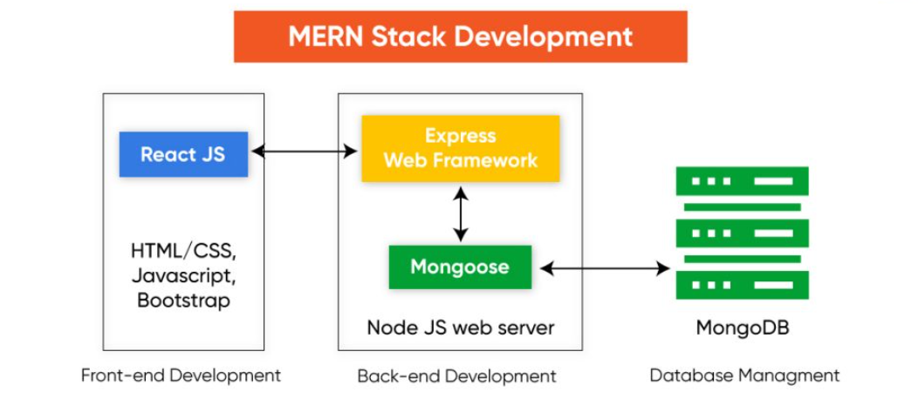

Slide 3
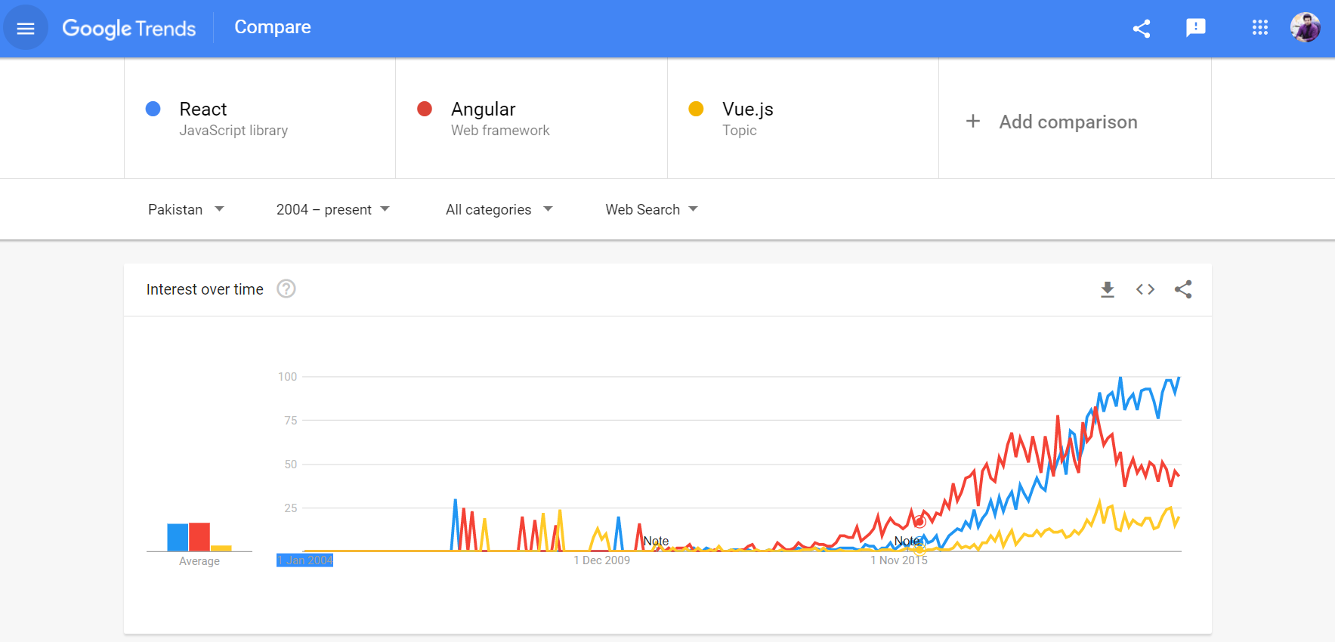

Slide 4
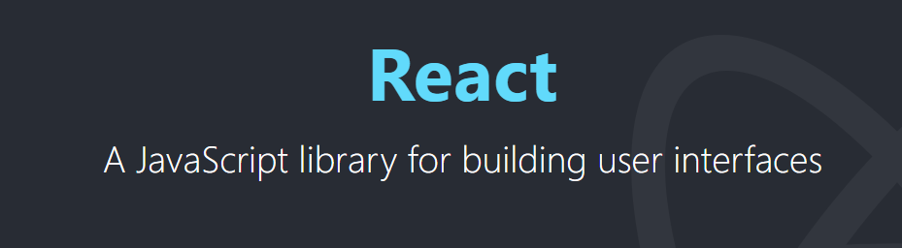
Developed by Facebook 2011
Competitor : Angular & Vue
Components : User Interface (Small chunk of UI)
Reusable User Interface
Root Component, Component Tree
Virtual DOM : (Only component that needs to be updated in affected)
Speed ( No re-rendering of whole App)

Slide 5


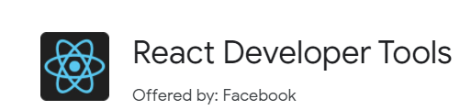
Development Environment

Slide 6
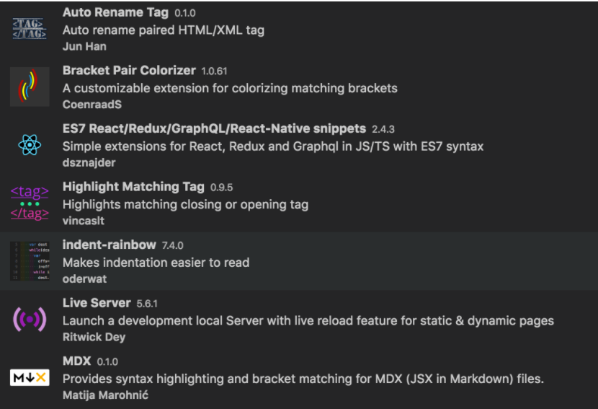
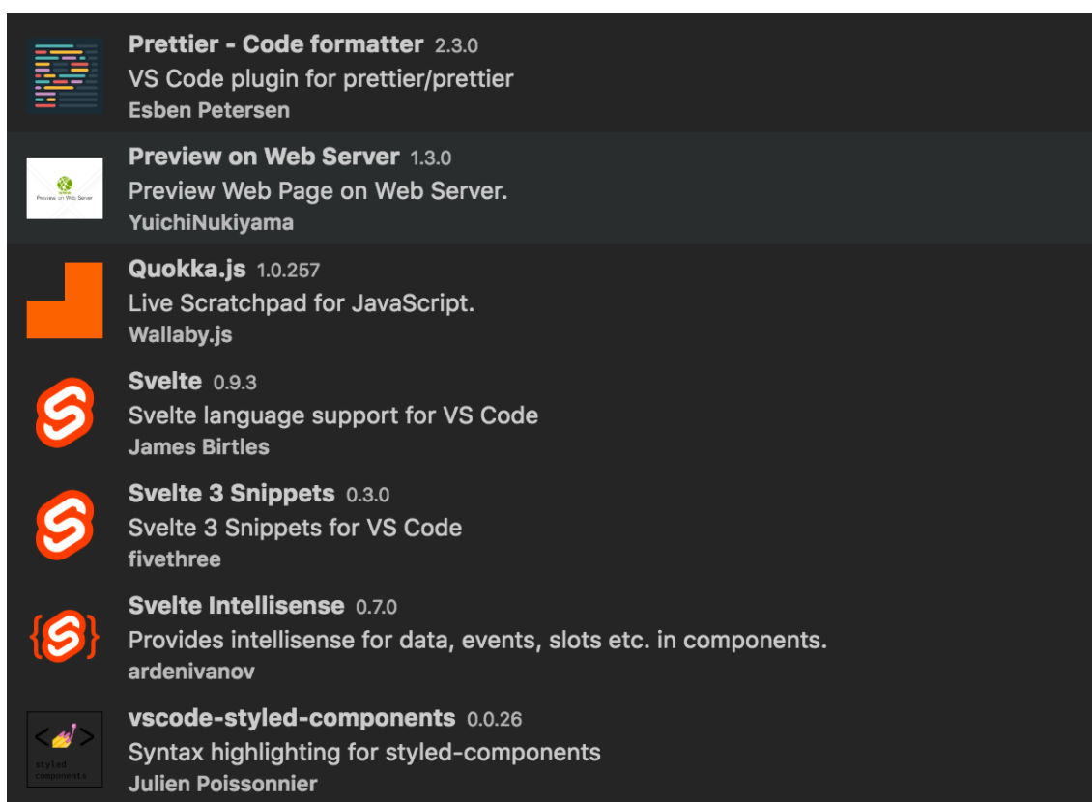
VS Code Extensions

Slide 7

Node Package Manager (NPM)
npm init
npm install <package name> --save
npm install <package name> -g
npm install <package name> --save-dev

Slide 8
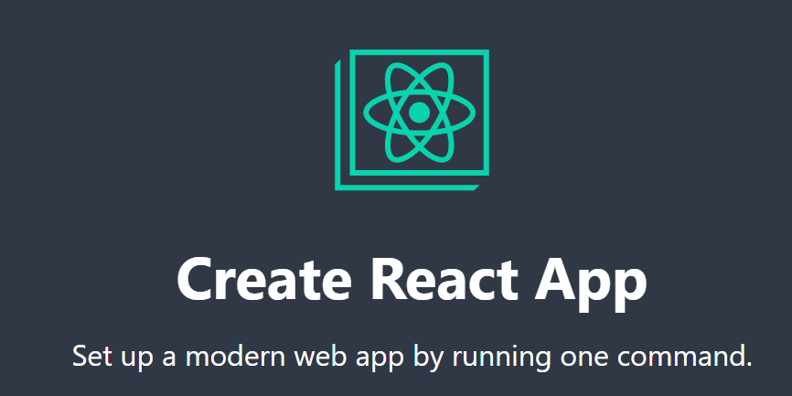
Create-React-App Tool
https://create-react-app.dev/
You can also create whole project yourself too

Slide 9

Covert Newest JS to Old JS
So App can run smoothly on Older browsers

Slide 10
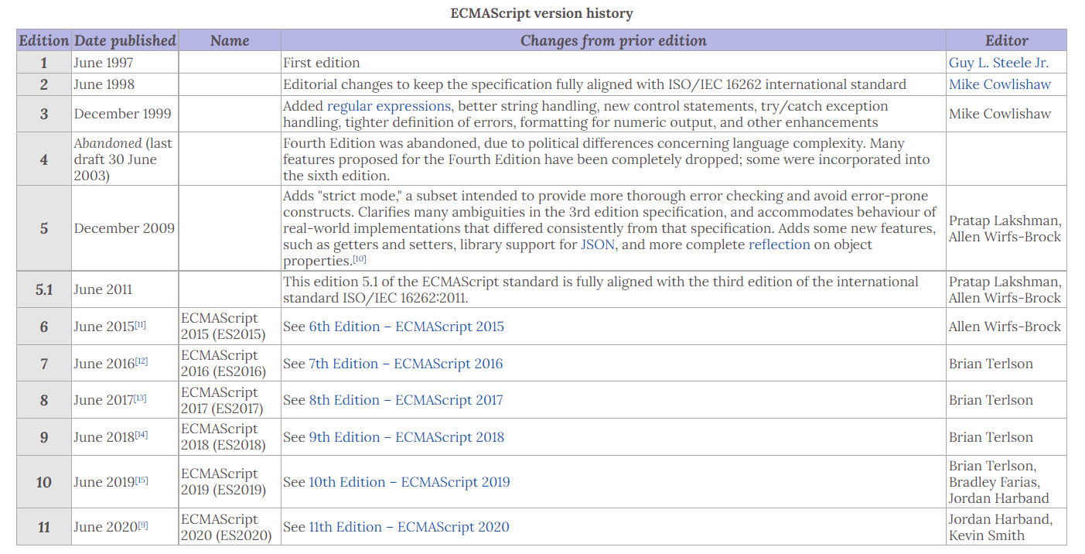

Slide 11

